Slide 1
Thumb Carpometacarpal Fusion with Distal Scaphoid Excision: A Novel Procedure for Pantrapezial Arthritis in the High Demand Hand. A Clinical and Biomechanical Study
Gary Lourie, MD; Scott Tanaka, MD; James Marino, MD; Charles Haddad, MD
Atlanta Medical Center, The Hand and Upper Extremity Center of Georgia

Slide 2
Methods
Thirteen fresh-frozen cadaveric upper extremity specimens were used in this study. Age range…. None of the specimens had evidence of prior surgery or trauma. A 2.0-mm K-wire was passed from the radius to the proximal scaphoid and from the radius to the lunate to reduce radiocarpal motion while taking measurements. A 2.0-mm K-wire was placed in a retrograde manner down the shaft of both the thumb metacarpal and index finger metacarpal. These K-wires were used as radiographic reference lines for all measurements. A standard dorsoradial approach to the thumb carpometacarpal joint and distal scaphoid was performed allowing exposure of the distal scaphoid for resection. This was performed prior to initial radiographs in an attempt to limit the soft tissue effect on range of motion. Initial flouroscopy images were taken using a mini C-arm in the PA plane with the thumb in palmar abduction and adduction and the lateral plane with the thumb in planar abduction and adduction. All PA images were taken with the elbow flexed at 90 degrees with the wrist in neutral and the palm flat on the table. True lateral images were obtained with the palmar cortex of the pisiform in the central third of the distance between the palmar cortex of the capitate and the palmar cortex of the distal pole of the scaphoid. A thumb trapeziometacarpal fusion was then simulated by passing two 1.6-mm K-wires across the trapeziometacarpal joint. The same four flouroscopic images were taken after the simulated fusion. The distal scaphoid was then excised using an osteotome and the four images were again obtained. The angle between the index finger metacarpal and thumb metacarpal K-wires were measured using Adobe Phostoshop Elements.

Slide 3
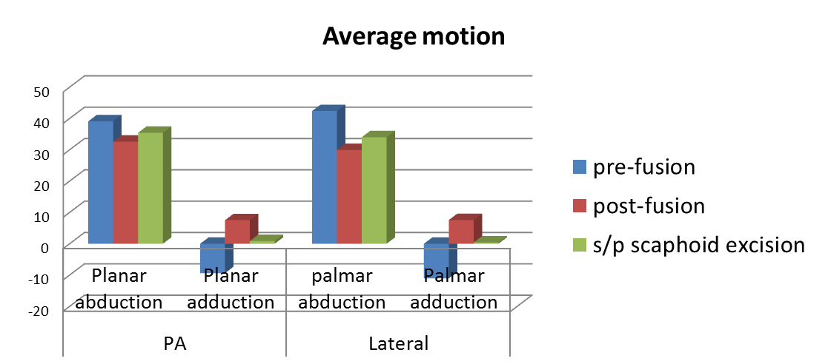
Results
 |  | pre-fusion | post-fusion | s/p scaphoid excision
Lateral | palmar abduction | 42.36 | 29.95 | 34.01
 | palmar extension | -11.05 | 7.56 | 0.39
PA | planar abduction | 39.09 | 32.58 | 35.42
 | planar adduction | -9.38 | 7.52 | 0.87

Slide 4
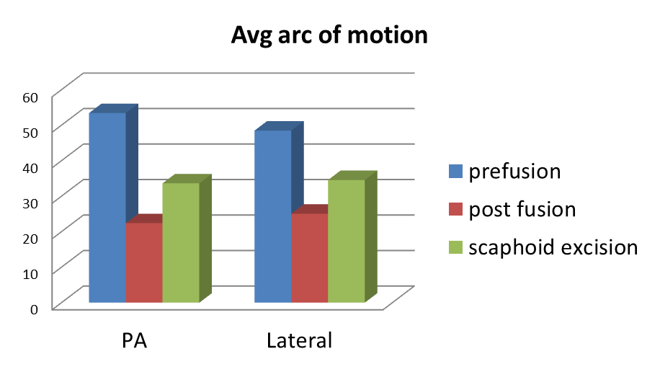
Results
Average arc of motion |  | prefusion | post fusion | scaphoid excision
 | PA | 53.41538 | 22.39231 | 33.61538
 | Lateral | 48.46923 | 25.05385 | 34.55385

Slide 5
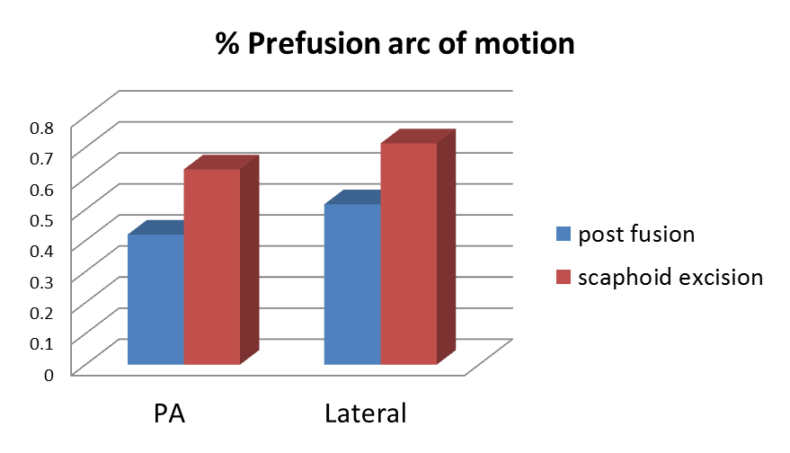
Results
 |  | post fusion | scaphoid excision
% prefusion arc of motion | PA | 0.419211 | 0.62932
 | Lateral | 0.516902 | 0.712903

Slide 6
Results
Average palmar abduction/adduction and planar abduction/adduction all improved with distal scaphoid excision compared to fusion alone, however, did not reach pre-fusion motion.
Average total arc of motion pre-fusion in the PA plane was 53.42 degrees (range 29.8-72 degrees) and 48.47 degrees (range 25.5-73.7 degrees). This decreased post-fusion to 22.4 and 25.05 degrees respectively. And improved to 33.62 and 34.55 degrees after distal scaphoid excision.
Shown as a percent of prefusion arc of motion, 42% and 52% of prefusion arc of motion remained postfusion in the PA and lateral planes, which improved to 63% and 71% of prefusion motion after distal scaphoid excision.

Slide 7
Results
Two specimens were found to have signs of thumb CMC degeneration on radiographs (Eaton stage 1 and 2).
  These specimens still demonstrated improved ROM after distal scaphoid excision except for the Eaton stage 2 specimen in the lateral plane (postfusion 67% of prefusion arc of motion decreased to 66% after distal scaphoid excision), however increased to 106% of prefusion motion after distal scaphoid excision in the PA plane.

Slide 8
Discussion
An increase in ROM in both the PA and lateral planes was observed after distal scaphoid excision compared to CMC fusion alone.
Although symptomatic relief after thumb CMC fusion provides adequate symptomatic relief, ROM of the thumb is significantly limited. Patients are often unable to place their palm flat on a table post fusion.
Distal scaphoid excision in addition to CMC fusion provides improved ROM of the thumb as shown in this cadaveric biomechanical study. This may lead to improved patient satisfaction and function after thumb CMC fusion.
Clinical correlation will be further examined to evaluate the effectiveness of this technique.
The effect of distal scaphoid excision on midcarpal stability and progression of degeneration in adjacent joints should also be further examined.

